Slide 1
BTGen Manual

Slide 2
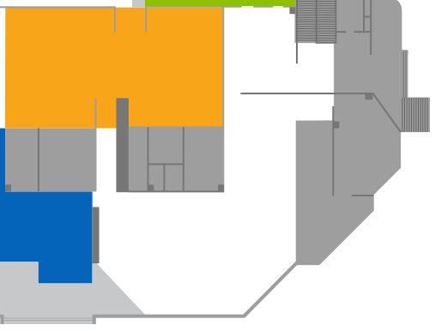






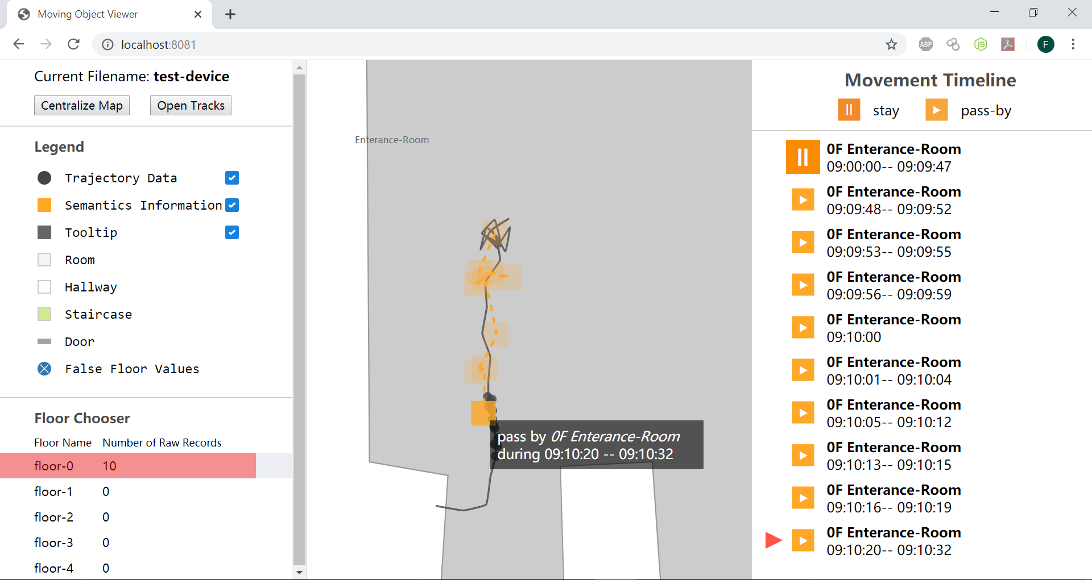
BT-Gen: Big Trajectory Generator
BT-Gen
Loader
Configurator
Generator
Library
Trajectories Data
System Input
Visualization

Slide 3
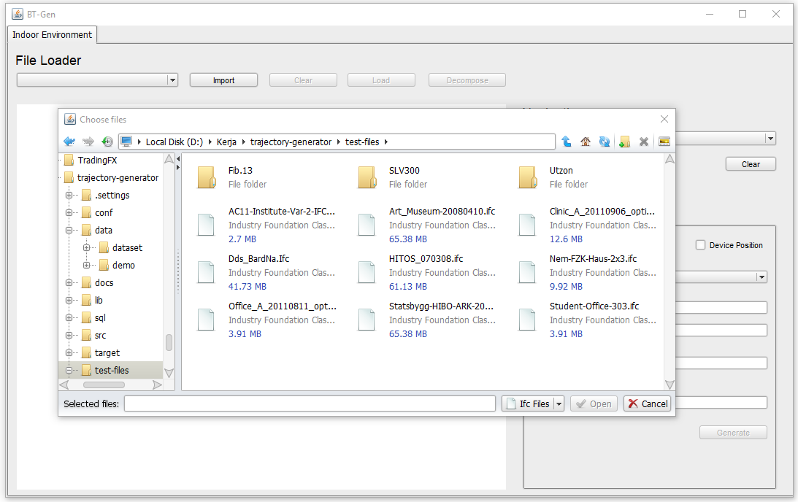
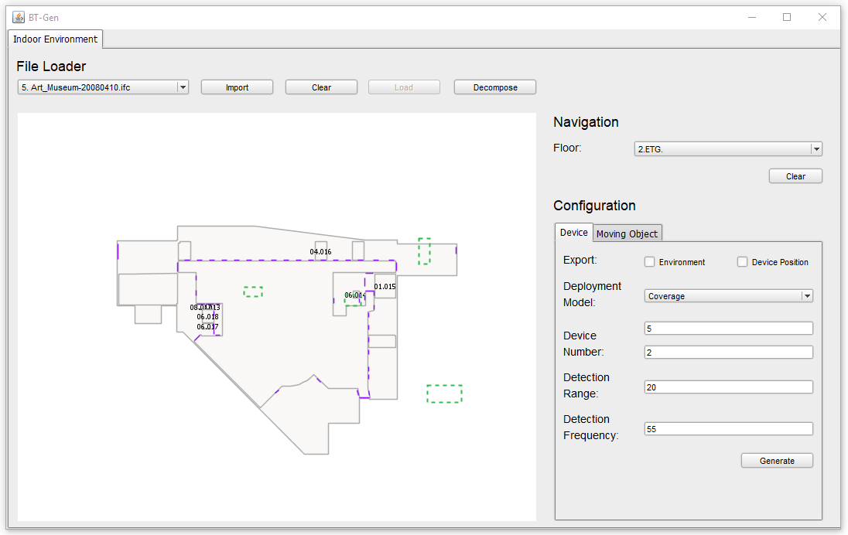
BT-Gen: Big Trajectory Generator
Data Loader
Read BMI floor plan and extract some information such as floor, wall, and stairs.
Visualize floor plan in feasible way.
Import Floor Plan
Display Floor Plan

Slide 4
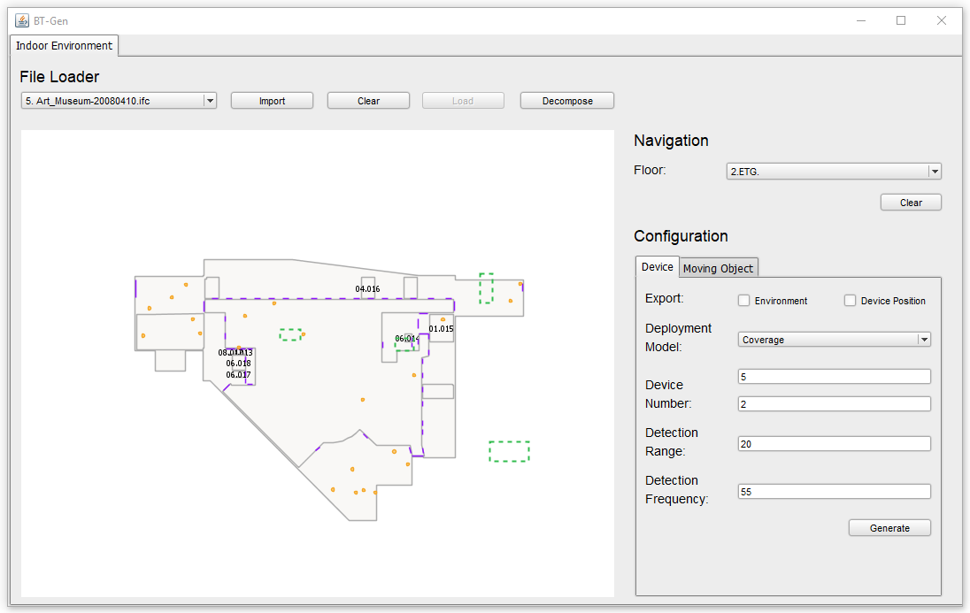
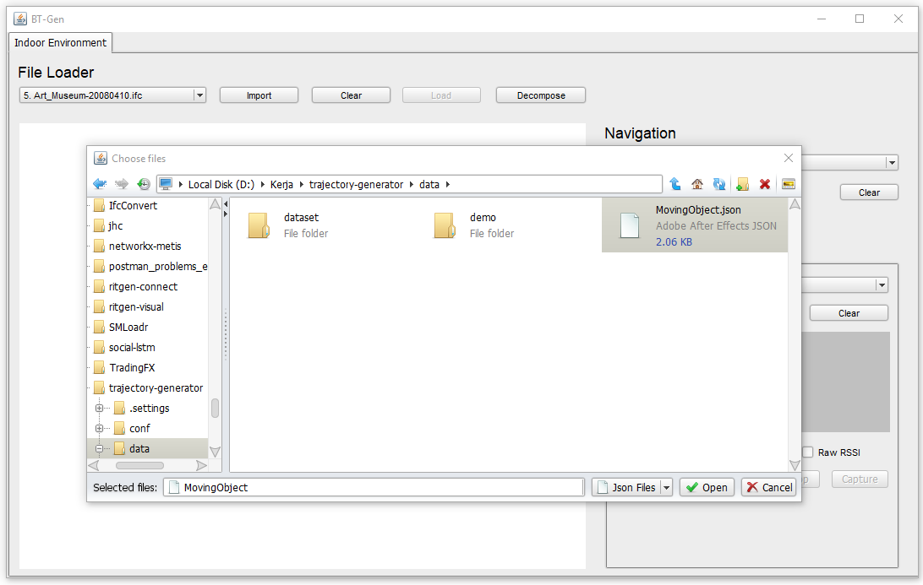
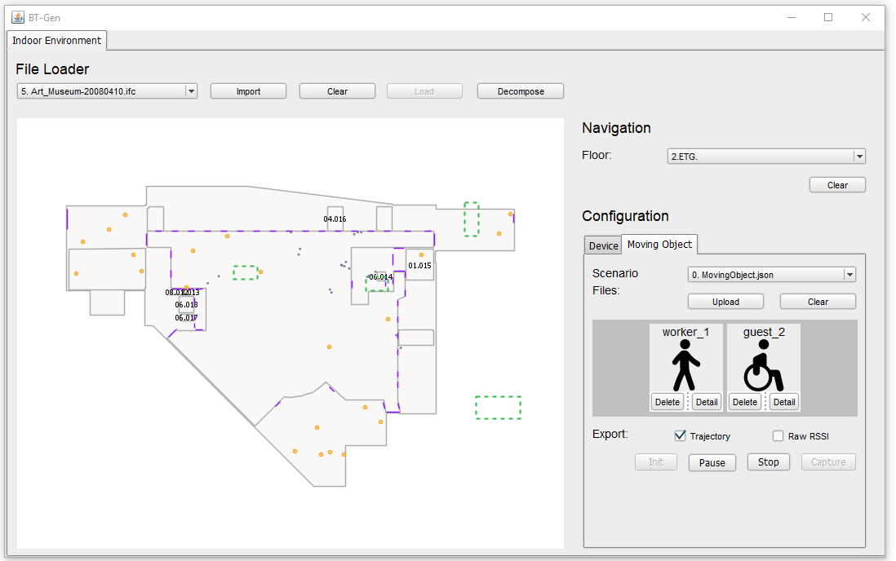
BT-Gen: Big Trajectory Generator
Trajectory Generation
Configure device and moving objects properties based on their floor plan.
Generate the trajectory data based on their mobility profiles.
Configure Device
Configure Moving Object
Generate Trajectory Data

Slide 5
BT-Gen: Big Trajectory Generator
Trajectory Visualization
Visualize movement history of trajectory data using web application.
Trajectory Visualization

